Slide 1

Semen Analysis
DR. Shereen H. Atef

Slide 2
Semen Analysis Include
Macroscopic
  viscosity
  coagulation + liquifaction
  volume
  pH
Microscopic
  concentration/count
  motility
  morphology
  viability
Motility &Viability must be performed within 1½ - 2 hrs of collection

Slide 3
REMEMBER
SEMEN IS A BODY FLUID
BIOHAZARDOUS

Slide 4
Semen Collection
Name
Period of abstinence - 2-7days
Time of collection
Entire ejaculate and not coitus interruptus in a wide mouth container
Delivered within 1/2 hour of collection
Avoid temperature extremes

Slide 5
Reference Ranges
Volume 2.0-6.0 ml
pH 7.2-8.0
Count >20 million/ml
Total count > 40 million
Morphology > 30% normal form
Viability > 75%(50% in other)
WBC< 1million/ml
RBC none

Slide 6
Macroscopic Examination
Liquefies completely in 15-60 minutes; this must be complete before further testing (mix before further testing).
Appearance: homogenous white-gray opalescence.
  Brown/red in hematospermia
  Dense white turbid if inflammation and high WBC

Slide 7
Macroscopic Examination
Volume: in graduated cylinder or graduated pipette , or centrifuge tube free of contamination to the nearest 0.1 ml (2.0-6.0 ml)
Viscosity: gentle aspiration to 5ml pipette or plastic pipette then allowing to drop by gravity and observing the length of thread
  normal, more viscous, very viscous
pH: important parameter of motility and viability 7.2-8.0; measured by pH paper.

Slide 8
SEMEN ANALYSIS
The wet preparation – assessments
The characteristics assessed are:
  Motility (to be discussed later)
  Sperm aggregation (random clumping) – “some” is normal, but large clumps (each with hundreds of sperm) is abnormal
  Spermagglutination (between specific sites) – could suggest the presence of antisperm antibodies.
  Epithelial cells: usually present in small numbers
  Erythrocytes: should not be present
  Debris: particles smaller than sperm head, may be plentiful
  Bacteria and protozoa: presence indicates infection
© Oozoa Biomedical Inc, April 2005

Slide 9
SEMEN ANALYSIS
Motility assessment - types
% motile = the proportion of sperm with tail movement
Progression rating = the grade of progression shown by the majority of the sperm: this can be from 0 (all immotile) to 4 (all with rapid progression); or from a (rapid progression) to d (all immotile)
Differential motility count = proportion of sperm in each of 4 motility classes (rapid progressive; slow progressive; non-progressive; immotile)
© Oozoa Biomedical Inc, April 2005

Slide 10
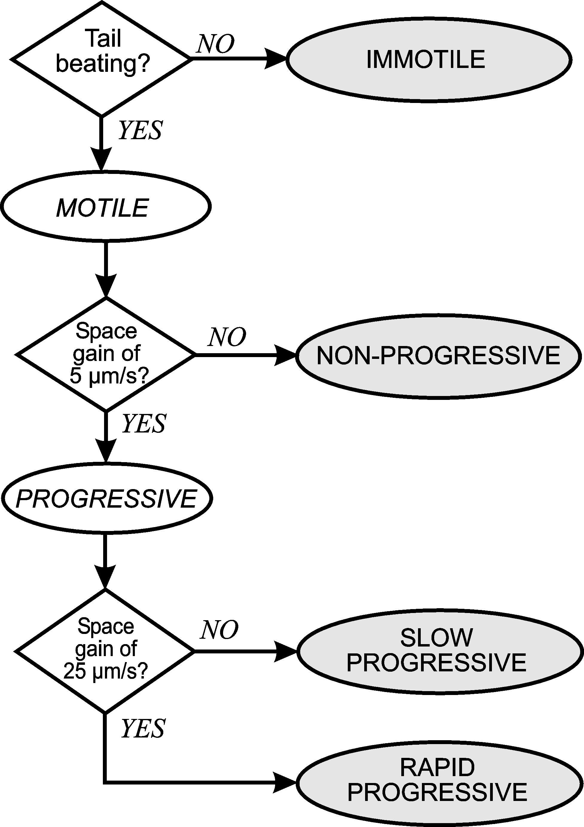
SEMEN ANALYSIS
Motility assessment – differential motility
Differential motility classification is based on the distance swum over time:
  A)Rapid progressive: > 25 µm/s
  B)Slow progressive: 5 – 25 µm/s
  C)Non-progressive: < 5 µm/s
  D)Immotile: no flagellar movement
© Oozoa Biomedical Inc, April 2005

Slide 11
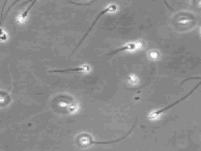

Slide 12
SEMEN ANALYSIS
Motility assessment – interpretation
The WHO’s Reference values for motility are:
  50% or more with progressive motility; or
  25% or more with rapid progressive motility
Assuming that all of the collection and laboratory factors have been controlled, a poor motility result may have negative implications for fertility.
However, this should be confirmed by a repeat semen analysis, and the result should be interpreted with the rest of the semen analysis results
© Oozoa Biomedical Inc, April 2005

Slide 13
SEMEN ANALYSIS
Sperm concentration- background
Sperm count = total number of sperm in the ejaculate
Sperm concentration = number of sperm per ml
(not “density”, which is an expression of mass / unit volume)
Most accurate method is volumetric dilution and haemocytometry
Must use a positive displacement pipettor
We make a 1 + 19 dilution with a fixative solution (allows the assessments to be batched - usually counted within two days)
© Oozoa Biomedical Inc, April 2005

Slide 14
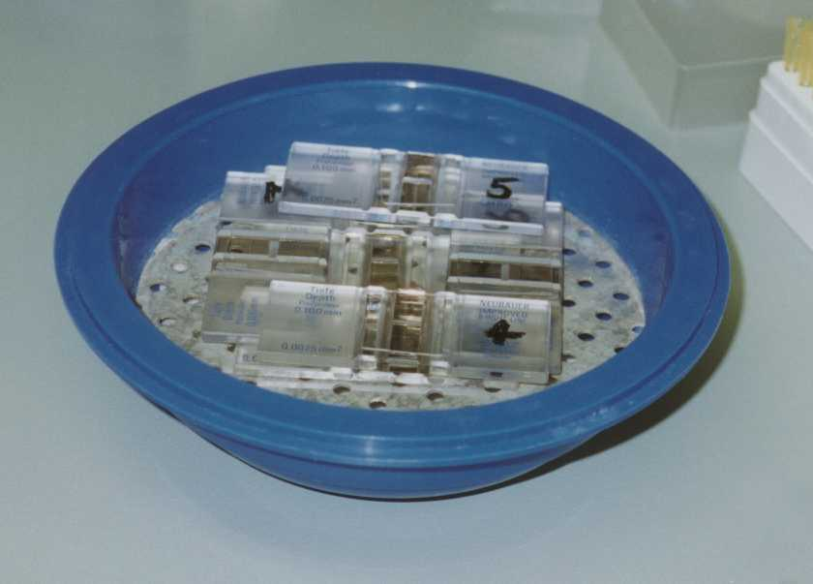
SEMEN ANALYSIS
Sperm concentration - method
Fix the haemocytometer coverslip over the chambers – ensure interference fringes can be seen
Vortex the fixed sample, load ~10 µl in both chambers
Leave in a humid chamber for 10-15 minutes
Count using a 20× objective and phase contrast optics
© Oozoa Biomedical Inc, April 2005

Slide 15
SEMEN ANALYSIS
Sperm concentration - haemocytometer
The number of squares assessed depends on the number of sperm counted in the first large square:
  If < 10 counted, the whole grid is assessed
  If 10-40 counted, 10 squares are assessed
  If > 40 counted, 5 squares are assessed
First large square counted
© Oozoa Biomedical Inc, April 2005

Slide 16
SEMEN ANALYSIS
Sperm concentration - calculations
If the counts of the two chambers are not within 5% of their average (i.e. the difference > 1/20 of their sum): discard, remix the sample, and set it up again
If the two counts are in agreement, then the sum of the two counts is divided by the correction factor:
  If 2 × 25 squares counted, divide their sum by 10
  If 2 × 10 squares counter, divide their sum by 4
  If 2 × 5 squares counted, divide their sum by 2
This gives the sperm concentration in millions per ml
Sperm count = concentration × total volume
© Oozoa Biomedical Inc, April 2005

Slide 17
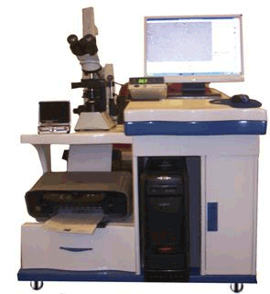
Mira1000 Semen Analyzer (CASA)

Slide 18
Agglutination
Reported when motile sperm stick to each other in a definite pattern.
  Head-head
  Tail-tail
  Head-tail
Immunological cause of infertility

Slide 19
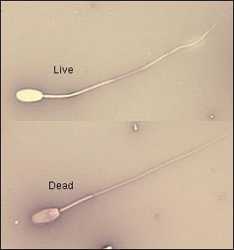
Viability
Supravital stain:
  Eosin +/- Nigrosin
    Viable do not take up the stain
This distinguish live nonmotile from dead; it is important to compare viability and motility.

Slide 20
SEMEN ANALYSIS
Sperm morphology – background
Morphology is even more important than motility and concentration
Because of the small size of the human sperm head, must use an air-dried smear which has been stained
The Papanicolaou method is best
Prepared samples are assessed using a 100× oil-immersion objective under bright field optics
The WHO recommends that 200 spermatozoa are counted per sample (and says that 2 × 200 is better)
Fields for counting must be selected at random
When counting, remember about the normal distribution
© Oozoa Biomedical Inc, April 2005

Slide 21
Other Sperm Abnormalities
Head abnormalities:
  absence
  double head
  micro/megalo
Tail abnormalities:
  coiled
  kinked
  lengthened

Slide 22
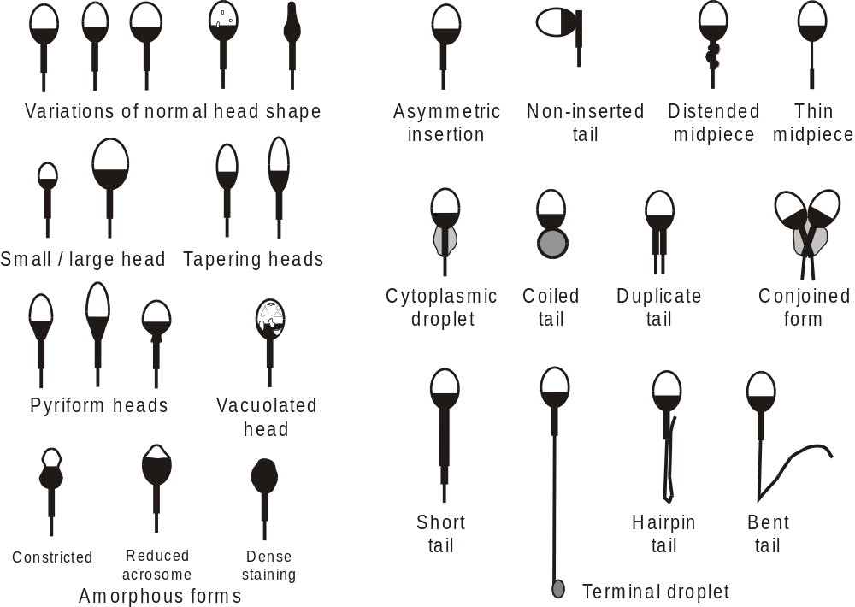
SEMEN ANALYSIS
Sperm morphology – morphology types
© Oozoa Biomedical Inc, April 2005

Slide 23
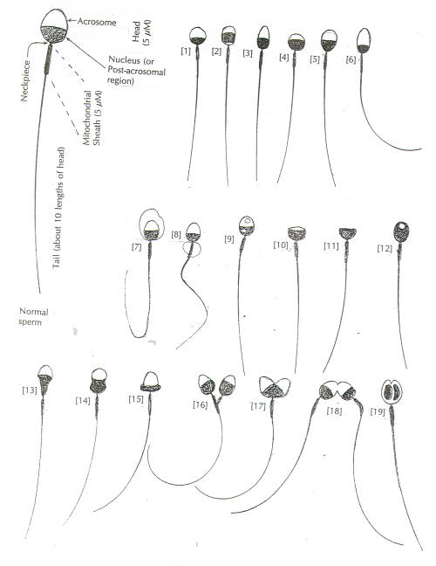

Slide 24
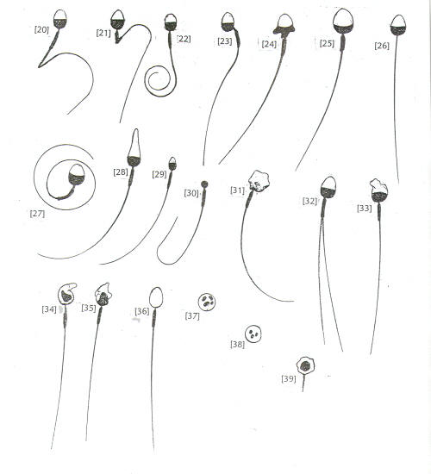

Slide 25
Aspermia: No semen ejaculated
Hematospermia: Blood present in semen
Leucocytospermia: White blood cells present in semen
Azospermia: No spermatozoa found in semen
Normospermia: Normal semen parameters
Oligospermia: Low sperm concentration
Asthenospermia: Poor motility and/or forward progression
Teratospermia: Reduced percentage of morphologicall normal sperm
Necrospermia: No live sperm in semen

